Slide 1

Fluffy Paw The animal adoption App
Elly Woo
30033719

Slide 2
Abstract
Goal
The project “Fluffy Paw” is a user-focused and innovative pet adoption Windows application that make users can enjoy a more convenient and seamless experience utilising a dedicated windows application, which will improve their access to the platform's services.
Time Frame
- 12 weeks (26/10 - 08/11)

Slide 3
Introduction
Animal adoption Windows application
supports animal charities in Rotorua
language
C# and Xaml with Microsoft visual studio
SQLite Database
laptop computer

Slide 4
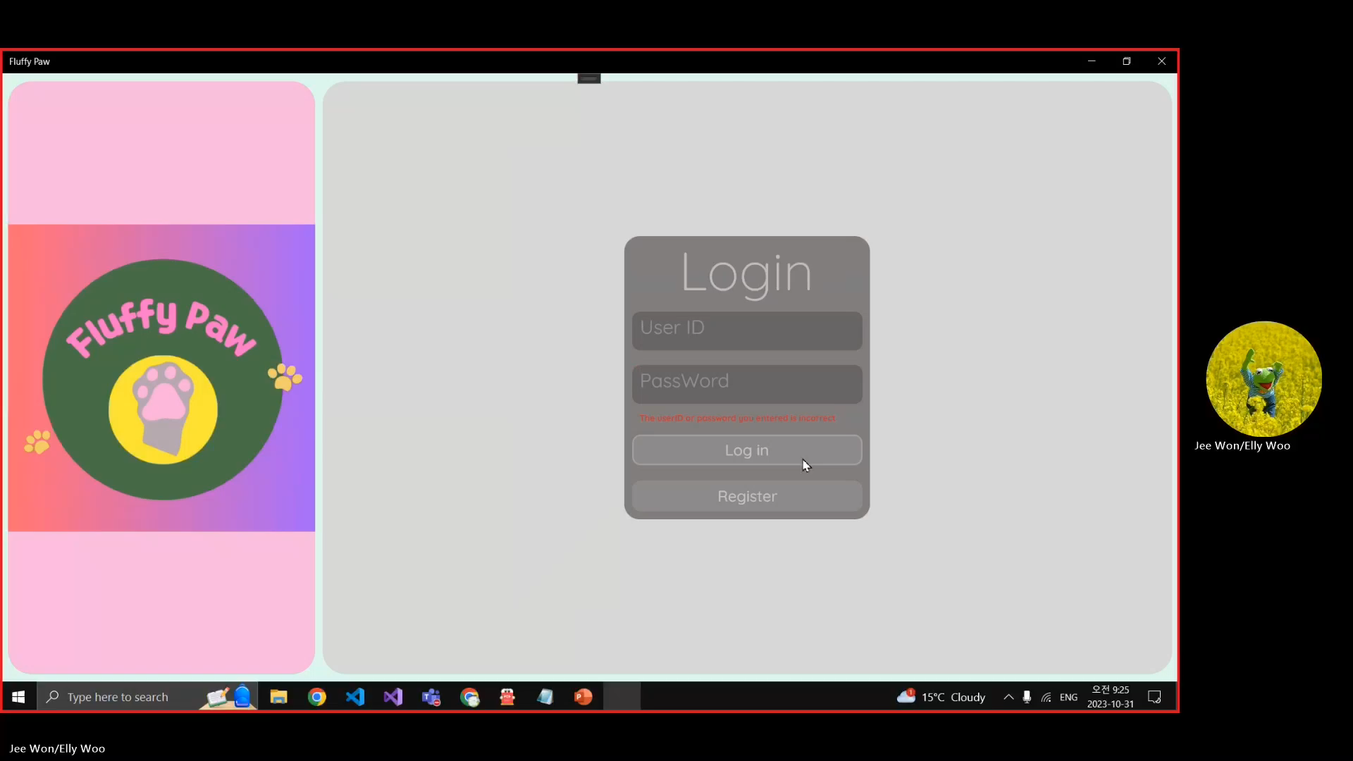

Slide 5
Objective & Scope
Objective | Scope
Improve service quality | Pet adoption list - including profiles and details
Attract new users | Missing and Sighting pet board location page
Encourage animal adoption | Donation page
Support animal community | filter features
Increase donation | Login and create account function
Quick Animal Rescue Assistance | Being Map location function

Slide 6
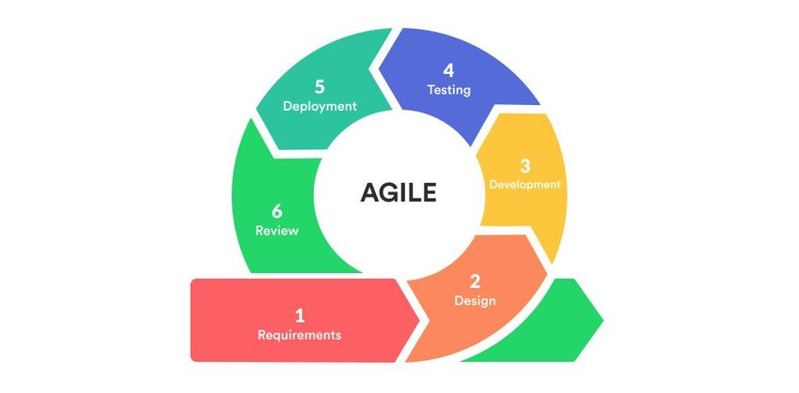
Methodology
Agile (Feature driven development)
MS planner
- It’s helpful tool for classifying tasks according to due dates and enabling easy progress monitoring inside individual plans.
- 22 tasks
- Labels (Done , working on)

Slide 7
Challenges & Issues
Challenges | Issues
Lack of experience | SQLite Database connection
Time management | Lack of sample windows application
Professional UI design | Login validation problem in SQLite
 | Filter function by combo-box

Slide 8
Achievements
The adoption windows application with login function.
Full stack development experience
Improved ways to find information
Learning UWP application and SQLite Database

